Slide 1
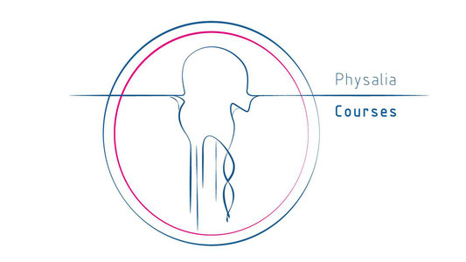
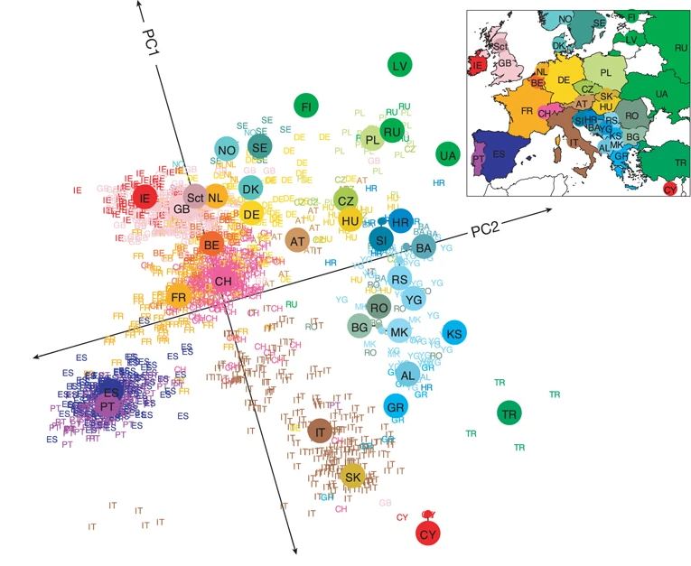
Genome scans
29/05/2025
Physalia course
Yann Bourgeois, Thibault Leroy
Notes:
Check http://www.uwyo.edu/dbmcd/molmark/lect11/lect11.html

Slide 2
Goals for today’s lecture
What is a genome-wide association study (GWAS)?
How can we detect selection in a single population?
How do we detect divergent selection?
A few methods to detect balancing selection.
The perils of interference and linkage.
As usual: a few limitations to keep in mind.

Slide 3
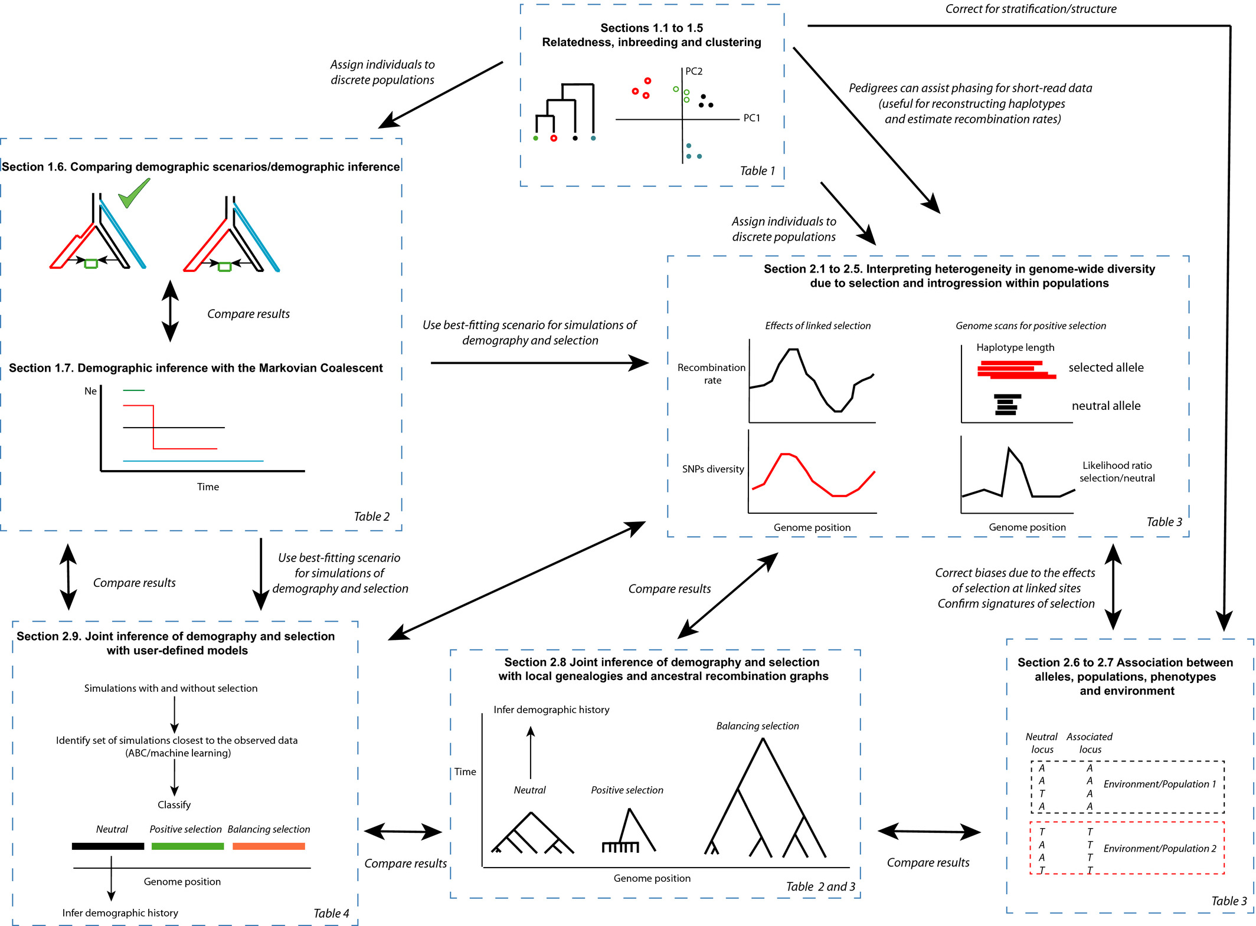
You are here...
TUESDAY
WEDNESDAY
TODAY (mostly)
Bourgeois, Y. X. C., & Warren, B. H. (2021) Molecular Ecology, 30, 6036–6071. https://doi.org/10.1111/mec.15989

Slide 4
Genome scans for association/adaptation
Cold
environment
Chromosome 1
Chromosome 2
Hot
environment
Neutral locus
Locus under selection
Allele 1 (advantageous in cold environments)
Allele 2 (advantageous in warm environments)
Notes:
Loci under selection should display an association with the selective pressure, such as alleles providing an advantage in a given condition are more frequent. Loci that are not giving any advantage do not show any particular signal. You can perform a scan on many individuals and populations, identify these loci with allele frequencies which are the most associated to environmental conditions, then come back at you individuals and populations and predict how adapted they are to the local environment.
You can then identify populations/individuals that display high frequencies at these alleles and assume they are more adapted to a given condition

Slide 5
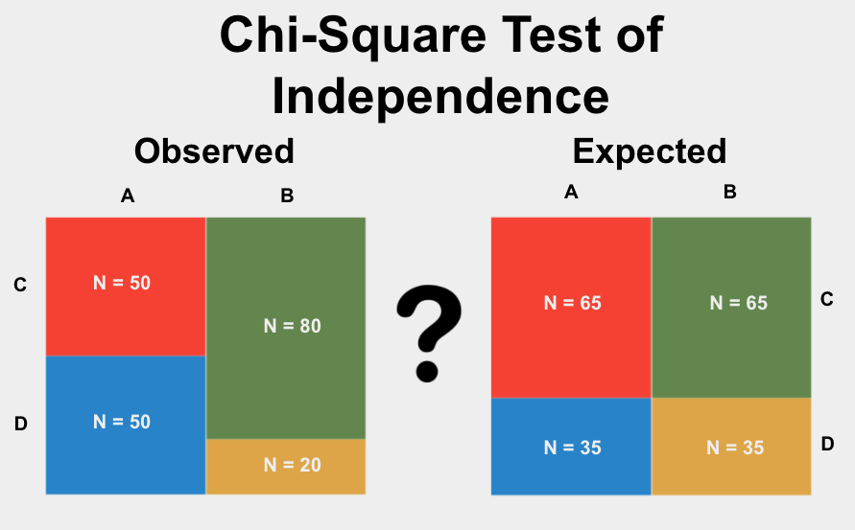
Genome Wide Scans of Association (GWAS)
The simplest: χ² test (--assoc in PLINK1.9, cf workshop)
Works only for discrete categories
Categories are not ordered
Not possible to directly account for structure or covariables.
statstest.com

Slide 6
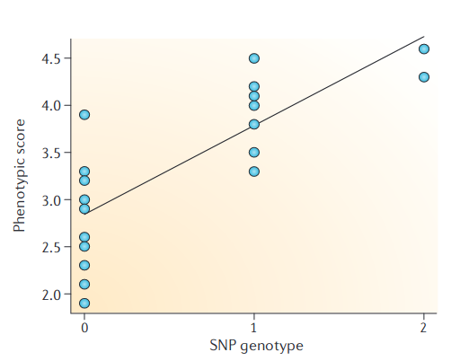
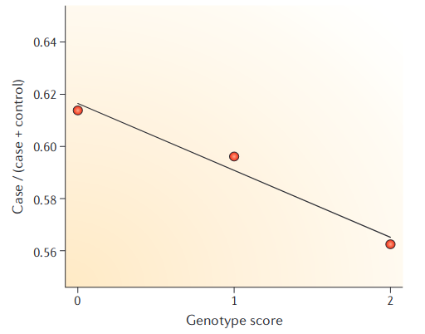
Genome Wide Scans of Association (GWAS)
Basic principle: a linear model of association.
intercept
genotype
Effect size (slope)
Continous phenotype
$Y=α+X⋅β+ϵ$
residuals
Continuous phenotype:
Linear regression
$ln\left(P/{\left(1−P\right)}\right)=α+X⋅β+ϵ$
Probability(case)
ln(odds ratio)
Binary phenotype (case-control):
Logistic regression
Balding Nat. Rev. Genet. 2010

Slide 7
Genome Wide Scans of Association (GWAS)
We can add confounding variables and complexify the model if desired.
Many statistical methods to increase power
Unless you are working with very large panels, do not overinterpret differences between methods.
More about this later...
$Y=α+X⋅β+u+ϵ$
Correction for population structure/relatedness
Can also be latent factors (LFMM2)
About LFMM2: Kevin Caye, Basile Jumentier, Johanna Lepeule, Olivier François, LFMM 2: Molecular Biology and Evolution, Volume 36, Issue 4, April 2019, Pages 852–860, https://doi.org/10.1093/molbev/msz008

Slide 8
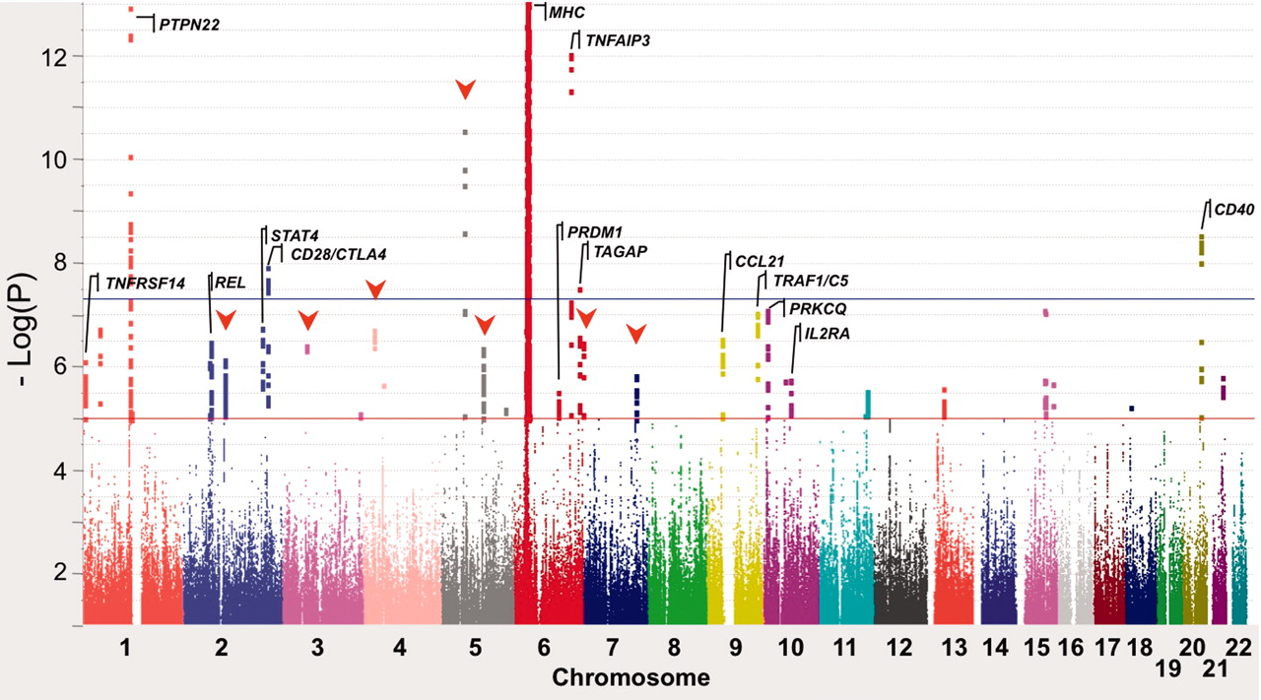
Genome Wide Scans of Association (GWAS)
Here a scan for association with rheumatoid arthritis
Cohorts with 100,000 or even million individuals
Useful to a point
For polygenic traits: need high sample size
Notes:
Loci under selection should display an association with the selective pressure, such as alleles providing an advantage in a given condition are more frequent. Loci that are not giving any advantage do not show any particular signal. You can perform a scan on many individuals and populations, identify these loci with allele frequencies which are the most associated to environmental conditions, then come back at you individuals and populations and predict how adapted they are to the local environment.
You can then identify populations/individuals that display high frequencies at these alleles and assume they are more adapted to a given condition

Slide 9
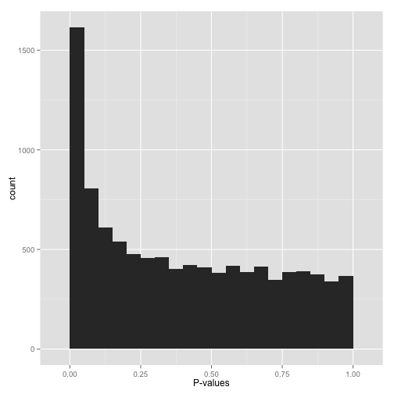
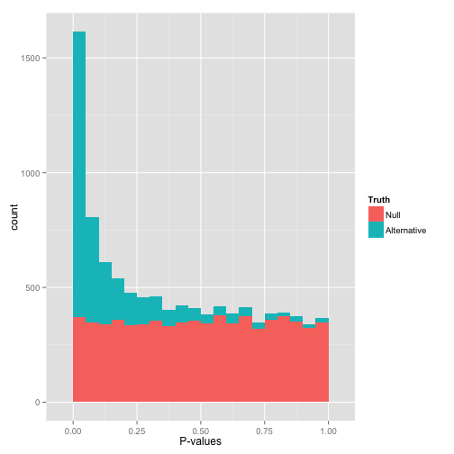
Always check your p-value distribution (not just for GWAS)
http://varianceexplained.org/statistics/interpreting-pvalue-histogram/
Notes:
Loci under selection should display an association with the selective pressure, such as alleles providing an advantage in a given condition are more frequent. Loci that are not giving any advantage do not show any particular signal. You can perform a scan on many individuals and populations, identify these loci with allele frequencies which are the most associated to environmental conditions, then come back at you individuals and populations and predict how adapted they are to the local environment.
You can then identify populations/individuals that display high frequencies at these alleles and assume they are more adapted to a given condition

Slide 10
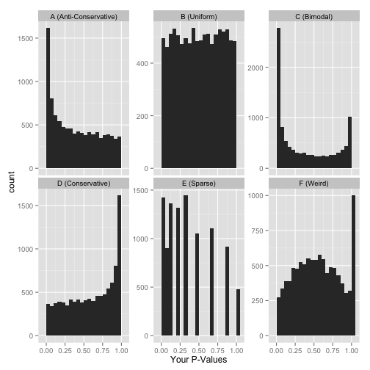
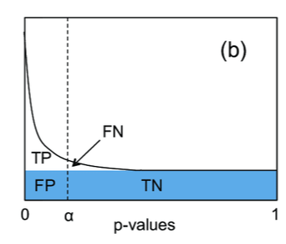
Always check your p-value distribution (not just for GWAS)
Notes:
Loci under selection should display an association with the selective pressure, such as alleles providing an advantage in a given condition are more frequent. Loci that are not giving any advantage do not show any particular signal. You can perform a scan on many individuals and populations, identify these loci with allele frequencies which are the most associated to environmental conditions, then come back at you individuals and populations and predict how adapted they are to the local environment.
You can then identify populations/individuals that display high frequencies at these alleles and assume they are more adapted to a given condition

Slide 11
Always check your p-value distribution (not just for GWAS)
You can apply a ‘brutal’ correction for multiple testing
Bonferroni correction: multiply your p-value by the number of tests
More subtle methods: q-value, the proportion of false positives for that particular p-value
Local False Discovery Rate (FDR): the probability that H0 is actually true given this particular p-value.
In R package qvalue
Requires the distribution of p-values to be uniform.
https://doi.org/doi:10.18129/B9.bioc.qvalue
Notes:
Loci under selection should display an association with the selective pressure, such as alleles providing an advantage in a given condition are more frequent. Loci that are not giving any advantage do not show any particular signal. You can perform a scan on many individuals and populations, identify these loci with allele frequencies which are the most associated to environmental conditions, then come back at you individuals and populations and predict how adapted they are to the local environment.
You can then identify populations/individuals that display high frequencies at these alleles and assume they are more adapted to a given condition

Slide 12
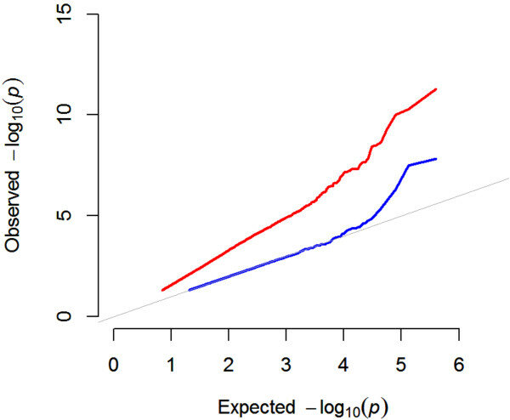
Correcting for p-value inflation
The expectation is one drawn assuming a χ² distribution
The ratio between observed and expected χ² values gives you a correction factor, called λ.
Genomic control
Notes:
Loci under selection should display an association with the selective pressure, such as alleles providing an advantage in a given condition are more frequent. Loci that are not giving any advantage do not show any particular signal. You can perform a scan on many individuals and populations, identify these loci with allele frequencies which are the most associated to environmental conditions, then come back at you individuals and populations and predict how adapted they are to the local environment.
You can then identify populations/individuals that display high frequencies at these alleles and assume they are more adapted to a given condition

Slide 13
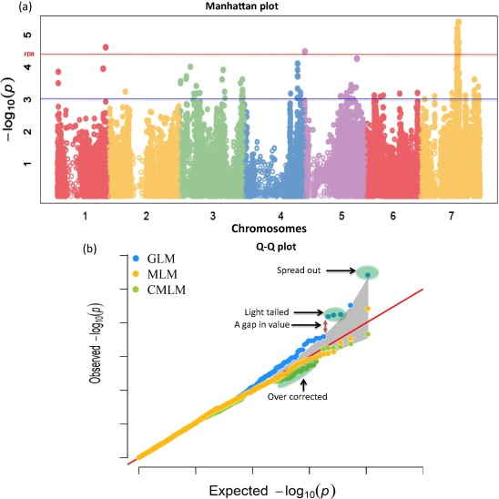
Always check your p-value distribution (not just for GWAS)
Notes:
Loci under selection should display an association with the selective pressure, such as alleles providing an advantage in a given condition are more frequent. Loci that are not giving any advantage do not show any particular signal. You can perform a scan on many individuals and populations, identify these loci with allele frequencies which are the most associated to environmental conditions, then come back at you individuals and populations and predict how adapted they are to the local environment.
You can then identify populations/individuals that display high frequencies at these alleles and assume they are more adapted to a given condition

Slide 14
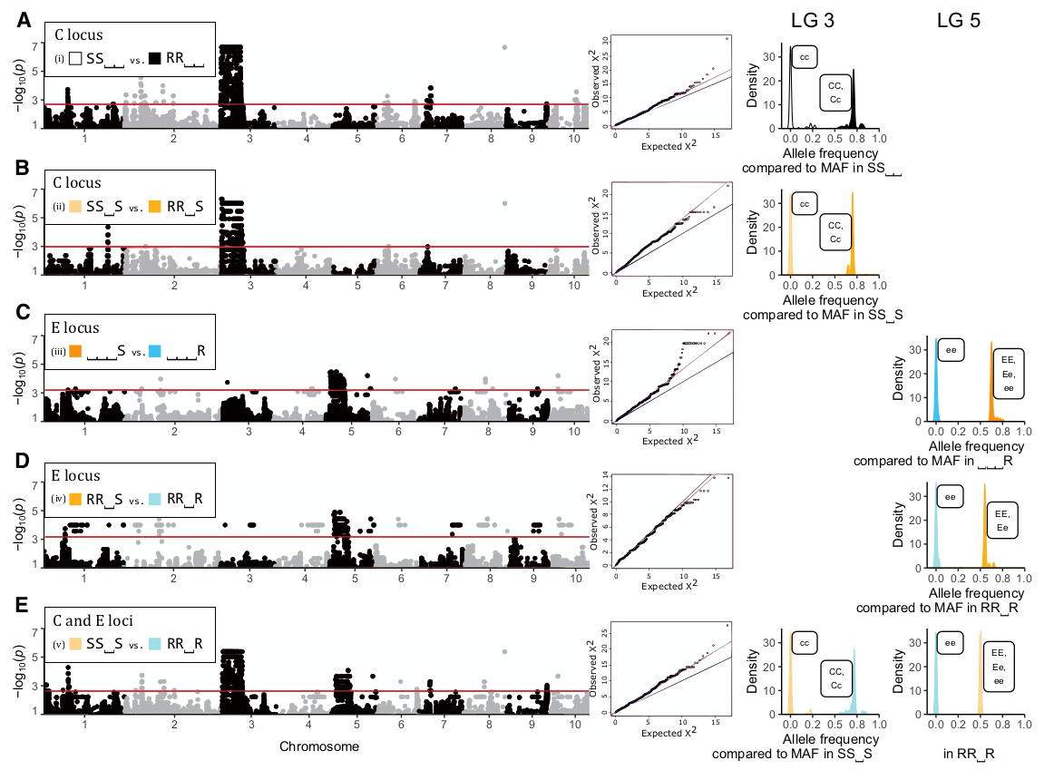

Slide 15
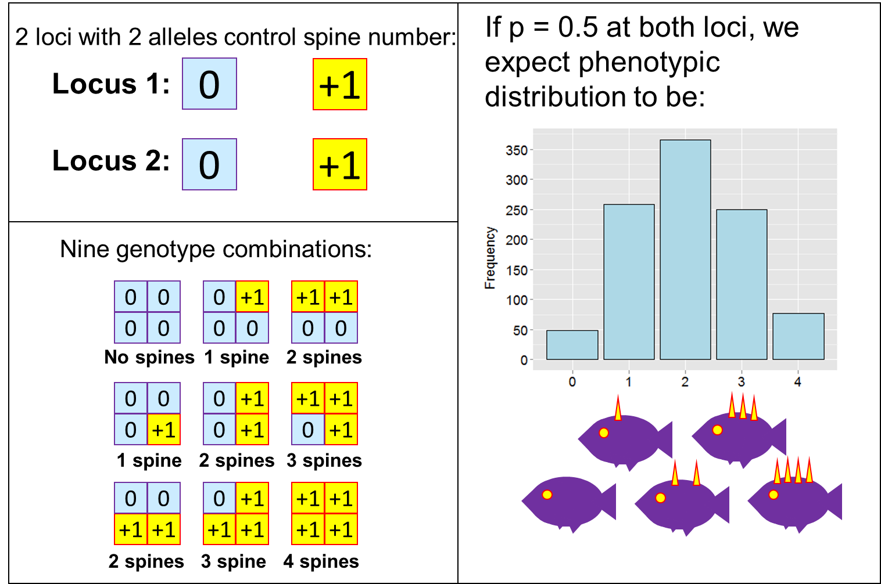
Back to quantitative genetics
Polygenic inheritance
Refers to quantitative characteristics controlled by cumulative effects of many genes
Each locus still follows Mendel’s rules
May be influenced by environmental factors
Kind of works, and simplifies things...

Slide 16
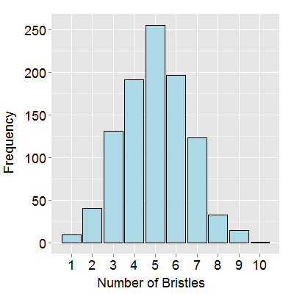
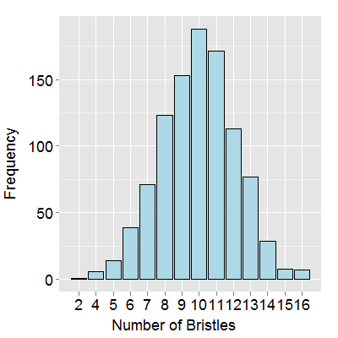
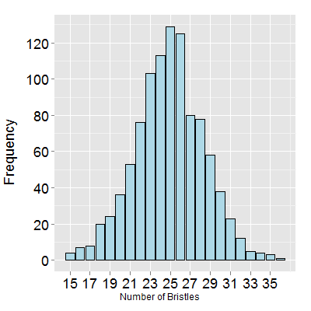
Back to quantitative genetics
As more loci control the trait, it becomes difficult to describe the trait in terms of individual loci
Central Limit theorem: the combination of random draws converges to a normal distribution.

Slide 17
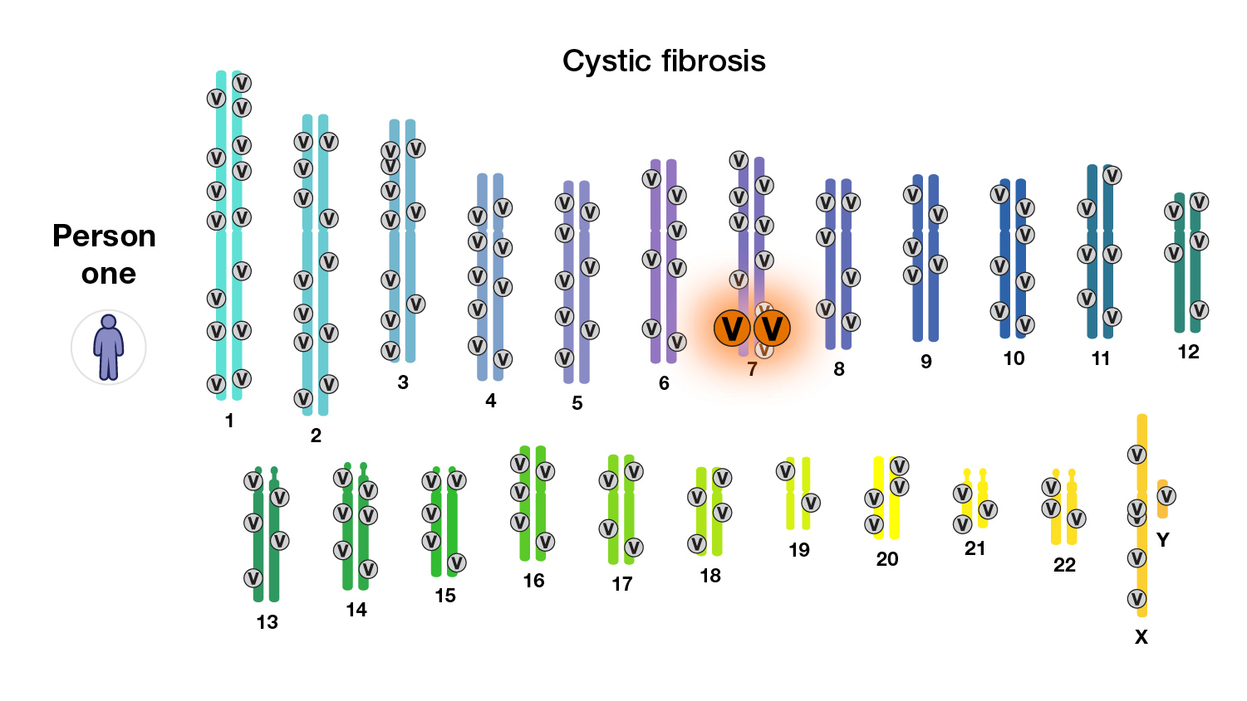
Polygenic risk scores
We assume additive effects
The risk is therefore additive.
Neglects epistasy.
Using genotypes at associated loci to predict an outcome
Here with a single locus

Slide 18
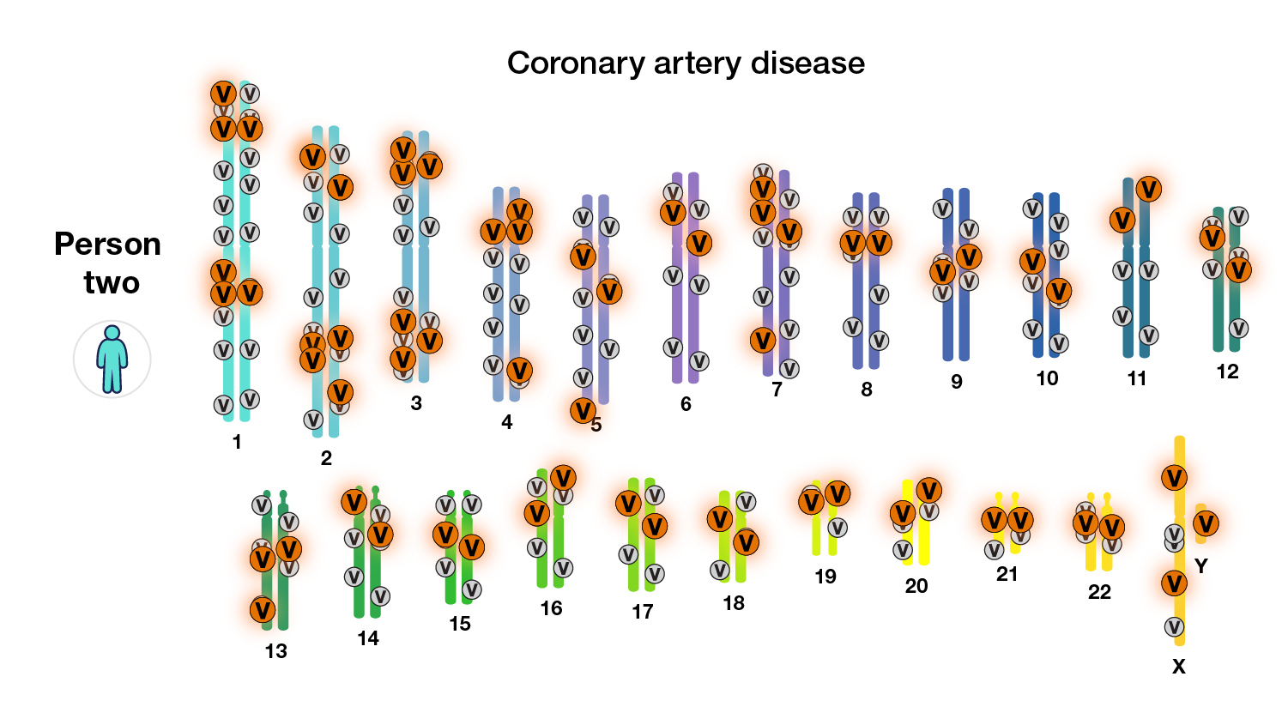
Polygenic risk scores
Using genotypes at associated loci to predict an outcome
Here with many loci

Slide 19
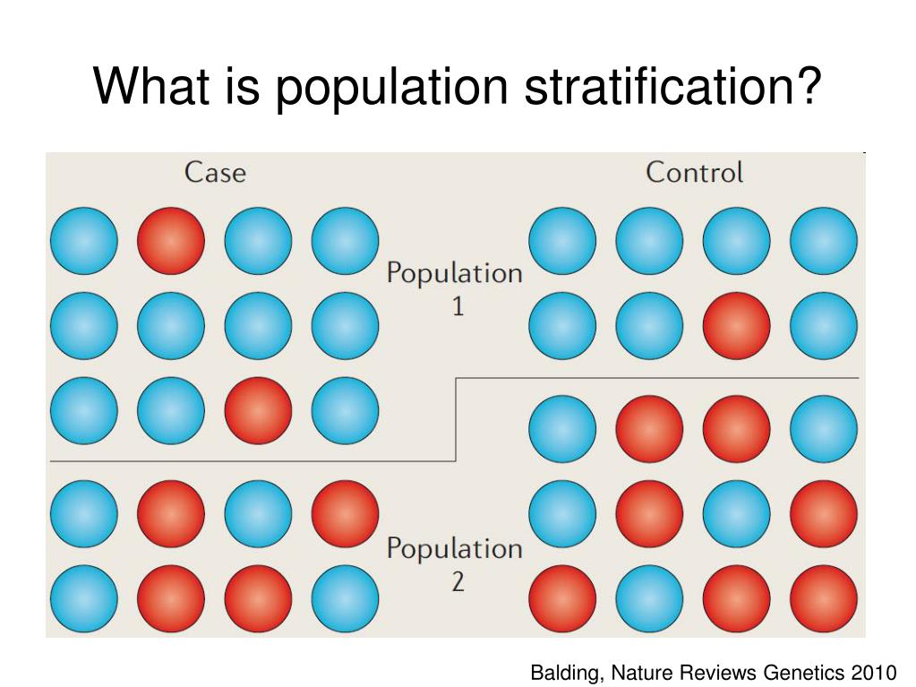
Genome Wide Scans of Association (GWAS): limitations and pitfalls
Small effect sizes
Biases due to population structure (stratification)
Ethnic bias
Story-telling
Look at the effect size, not just the p-value
Notes:
Loci under selection should display an association with the selective pressure, such as alleles providing an advantage in a given condition are more frequent. Loci that are not giving any advantage do not show any particular signal. You can perform a scan on many individuals and populations, identify these loci with allele frequencies which are the most associated to environmental conditions, then come back at you individuals and populations and predict how adapted they are to the local environment.
You can then identify populations/individuals that display high frequencies at these alleles and assume they are more adapted to a given condition

Slide 20
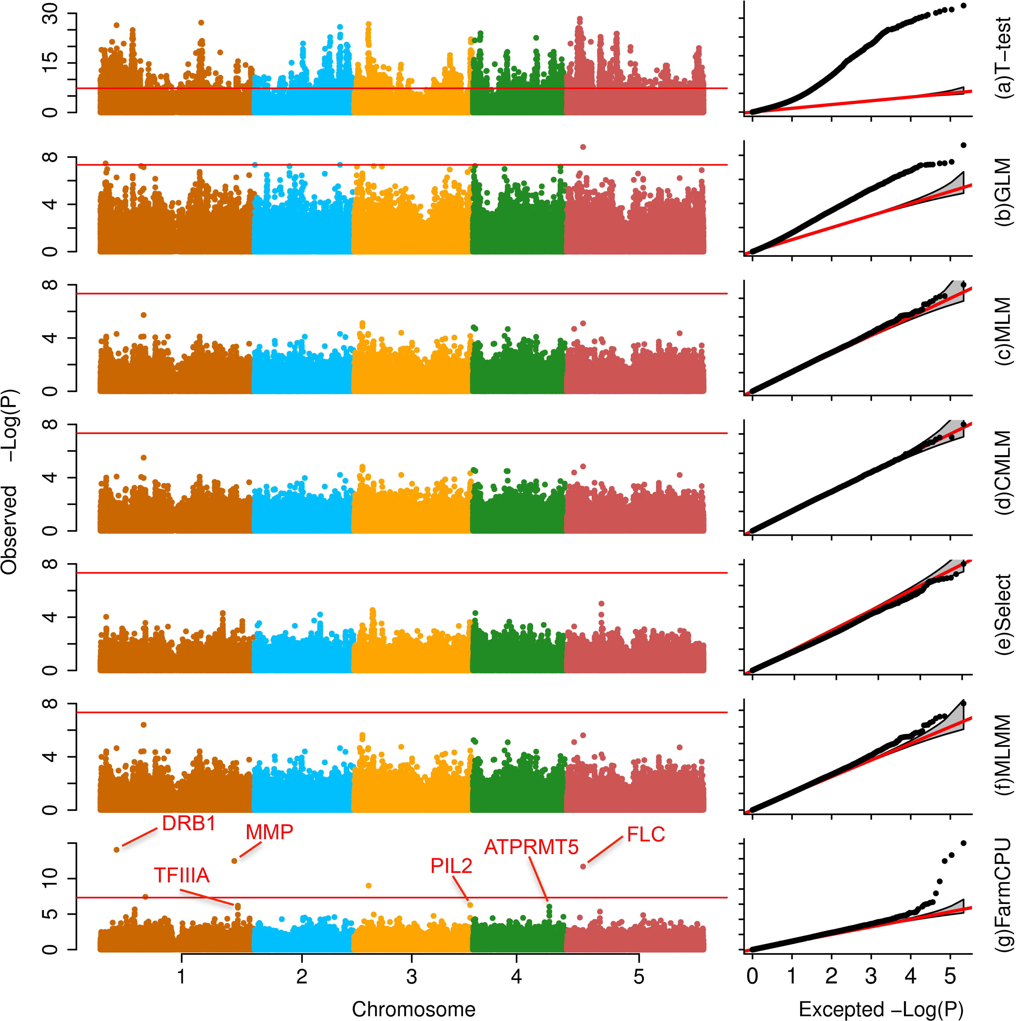
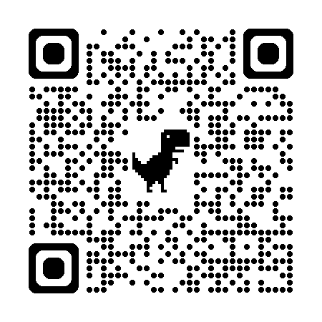
A few GWAS models
Notes:
Loci under selection should display an association with the selective pressure, such as alleles providing an advantage in a given condition are more frequent. Loci that are not giving any advantage do not show any particular signal. You can perform a scan on many individuals and populations, identify these loci with allele frequencies which are the most associated to environmental conditions, then come back at you individuals and populations and predict how adapted they are to the local environment.
You can then identify populations/individuals that display high frequencies at these alleles and assume they are more adapted to a given condition

Slide 21
A few GWAS models
Notes:
Loci under selection should display an association with the selective pressure, such as alleles providing an advantage in a given condition are more frequent. Loci that are not giving any advantage do not show any particular signal. You can perform a scan on many individuals and populations, identify these loci with allele frequencies which are the most associated to environmental conditions, then come back at you individuals and populations and predict how adapted they are to the local environment.
You can then identify populations/individuals that display high frequencies at these alleles and assume they are more adapted to a given condition

Slide 22
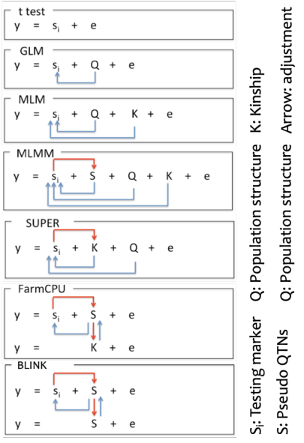
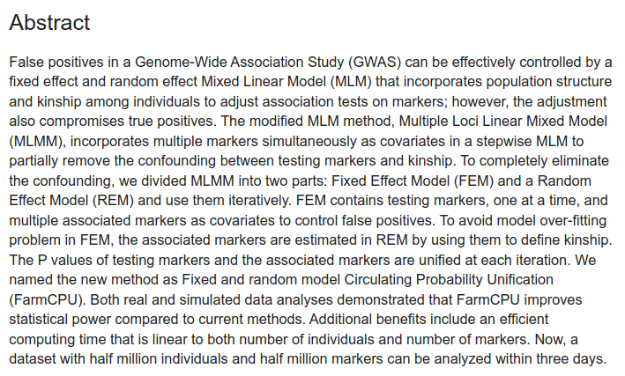
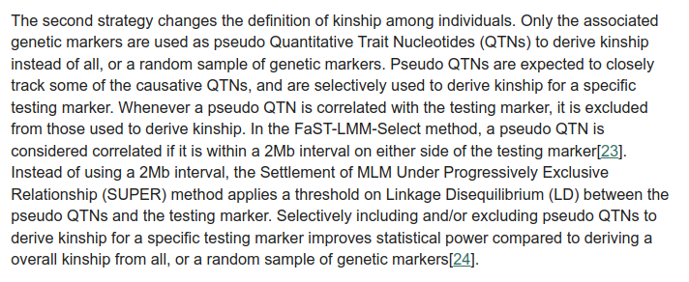

Slide 23
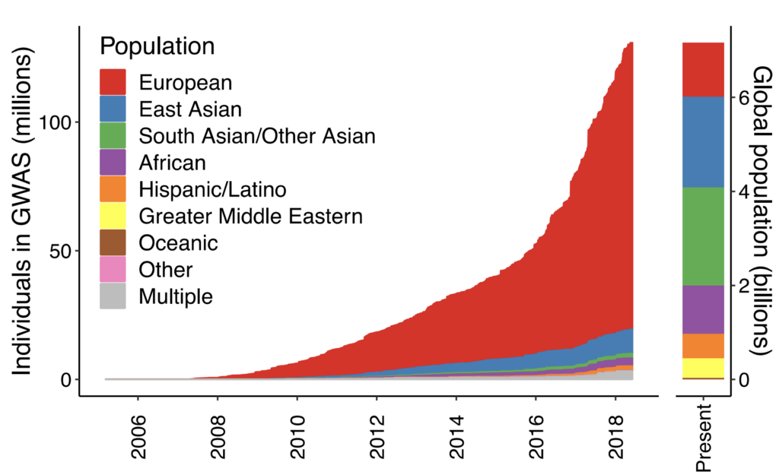
Genome Wide Scans of Association (GWAS): limitations and pitfalls
Small effect sizes
Biases due to population structure (stratification)
Ethnic bias
Story-telling
Look at the effect size (β), not just the p-value.
Martin et al. Nat Genet 2019.
Notes:
Loci under selection should display an association with the selective pressure, such as alleles providing an advantage in a given condition are more frequent. Loci that are not giving any advantage do not show any particular signal. You can perform a scan on many individuals and populations, identify these loci with allele frequencies which are the most associated to environmental conditions, then come back at you individuals and populations and predict how adapted they are to the local environment.
You can then identify populations/individuals that display high frequencies at these alleles and assume they are more adapted to a given condition

Slide 24
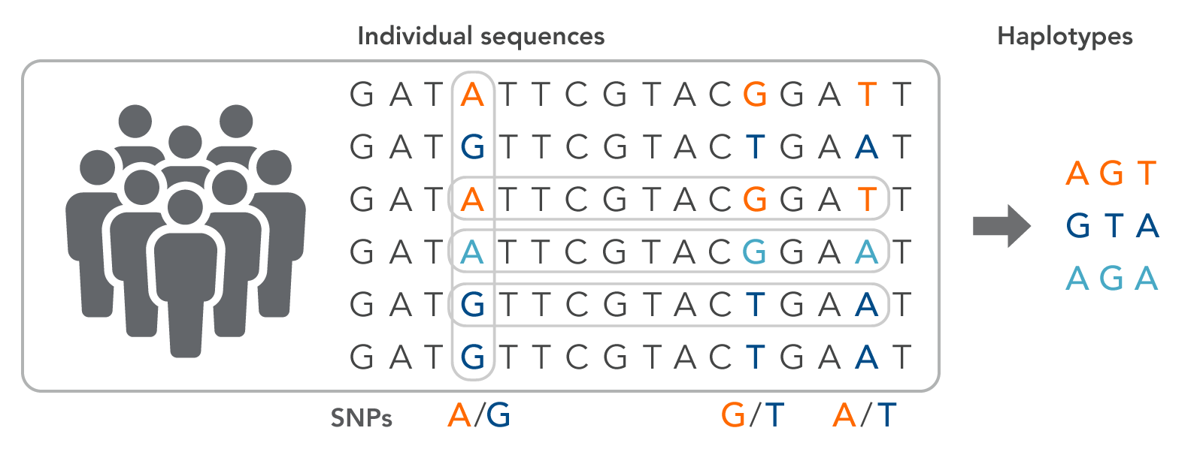
Scans for selection. Quick reminder
https://www.idtdna.com/pages/education/decoded/article/genotyping-terms-to-know

Slide 25
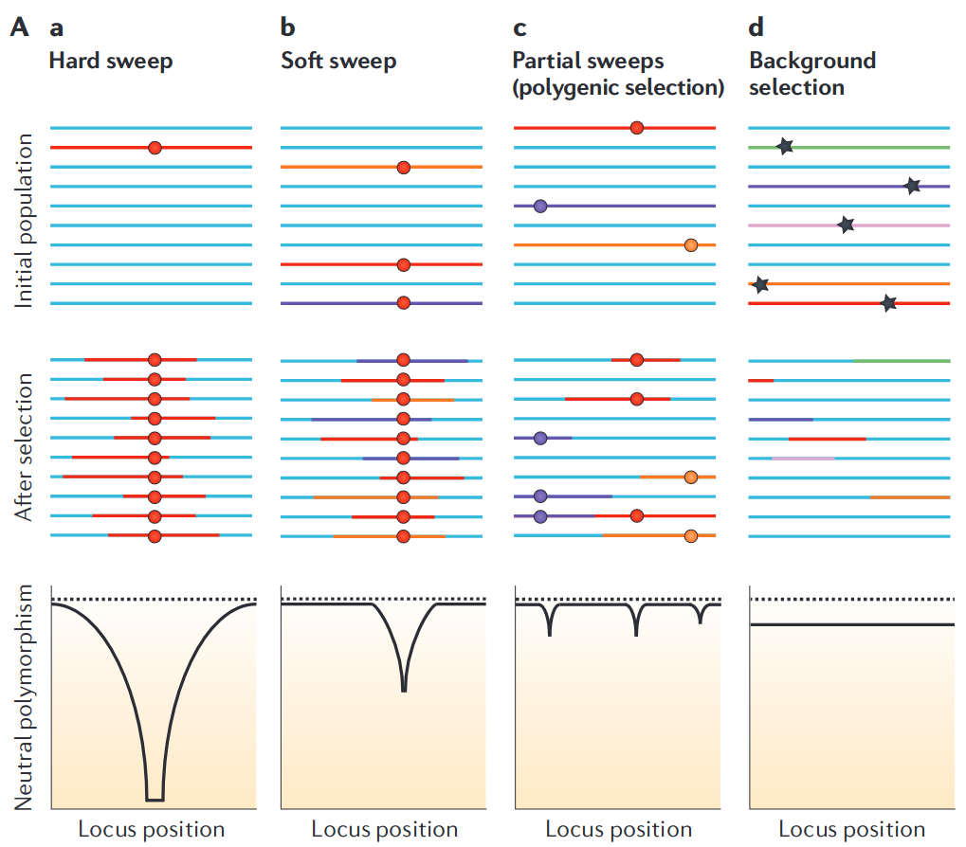
A (hard) selective sweep
The association between alleles across individuals usually breaks down because of recombination
Recent selection leads to a fast increase in frequency of the selected allele and those at the vicinity (selective sweep)
One consequence: drop in ‘how different’ alleles are near the selected locus
Fast rise in frequency
Cutter and Payseur Nat. Rev. Genet. 2013

Slide 26
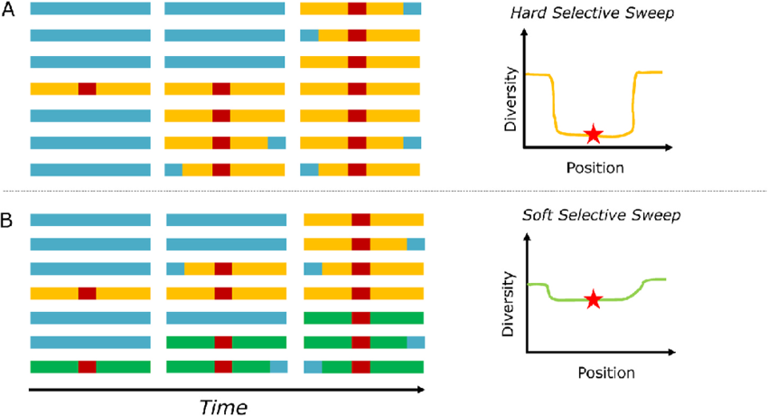
Effect on diversity statistics

Slide 27
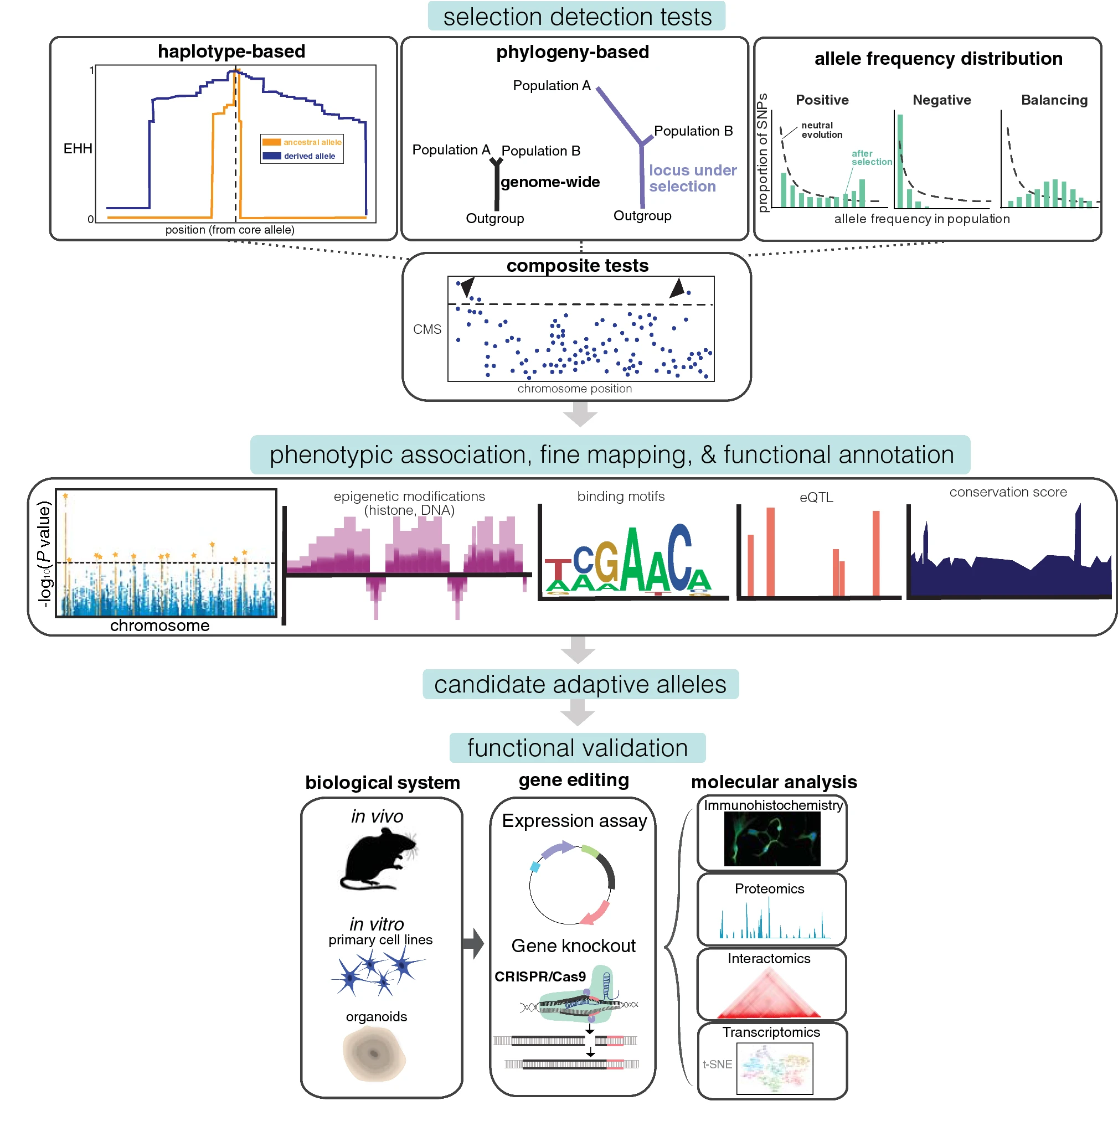
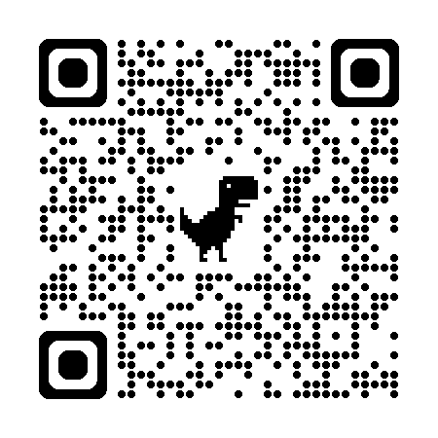
Effect on the Allele Frequency Spectrum
A selective sweep leads to a change in the frequency of derived alleles
This signature can be detected by contrasting local and global (or simulated) ‘neutral’ spectra
Can be described by diversity statistics, such as Tajima’s D

Slide 28
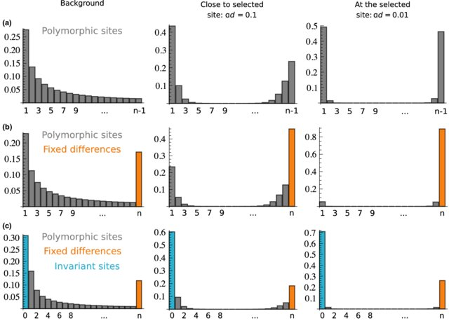
Effect on the Allele Frequency Spectrum
A selective sweep leads to a change in the frequency of derived alleles
This signature can be detected by contrasting local and global (or simulated) ‘neutral’ spectra
Can be described by diversity statistics, such as Tajima’s D
The entire spectrum can be used more efficiently: Composite Likelihood Ratios (CLR) estimated by SweepFinder/SweeD.

Slide 29
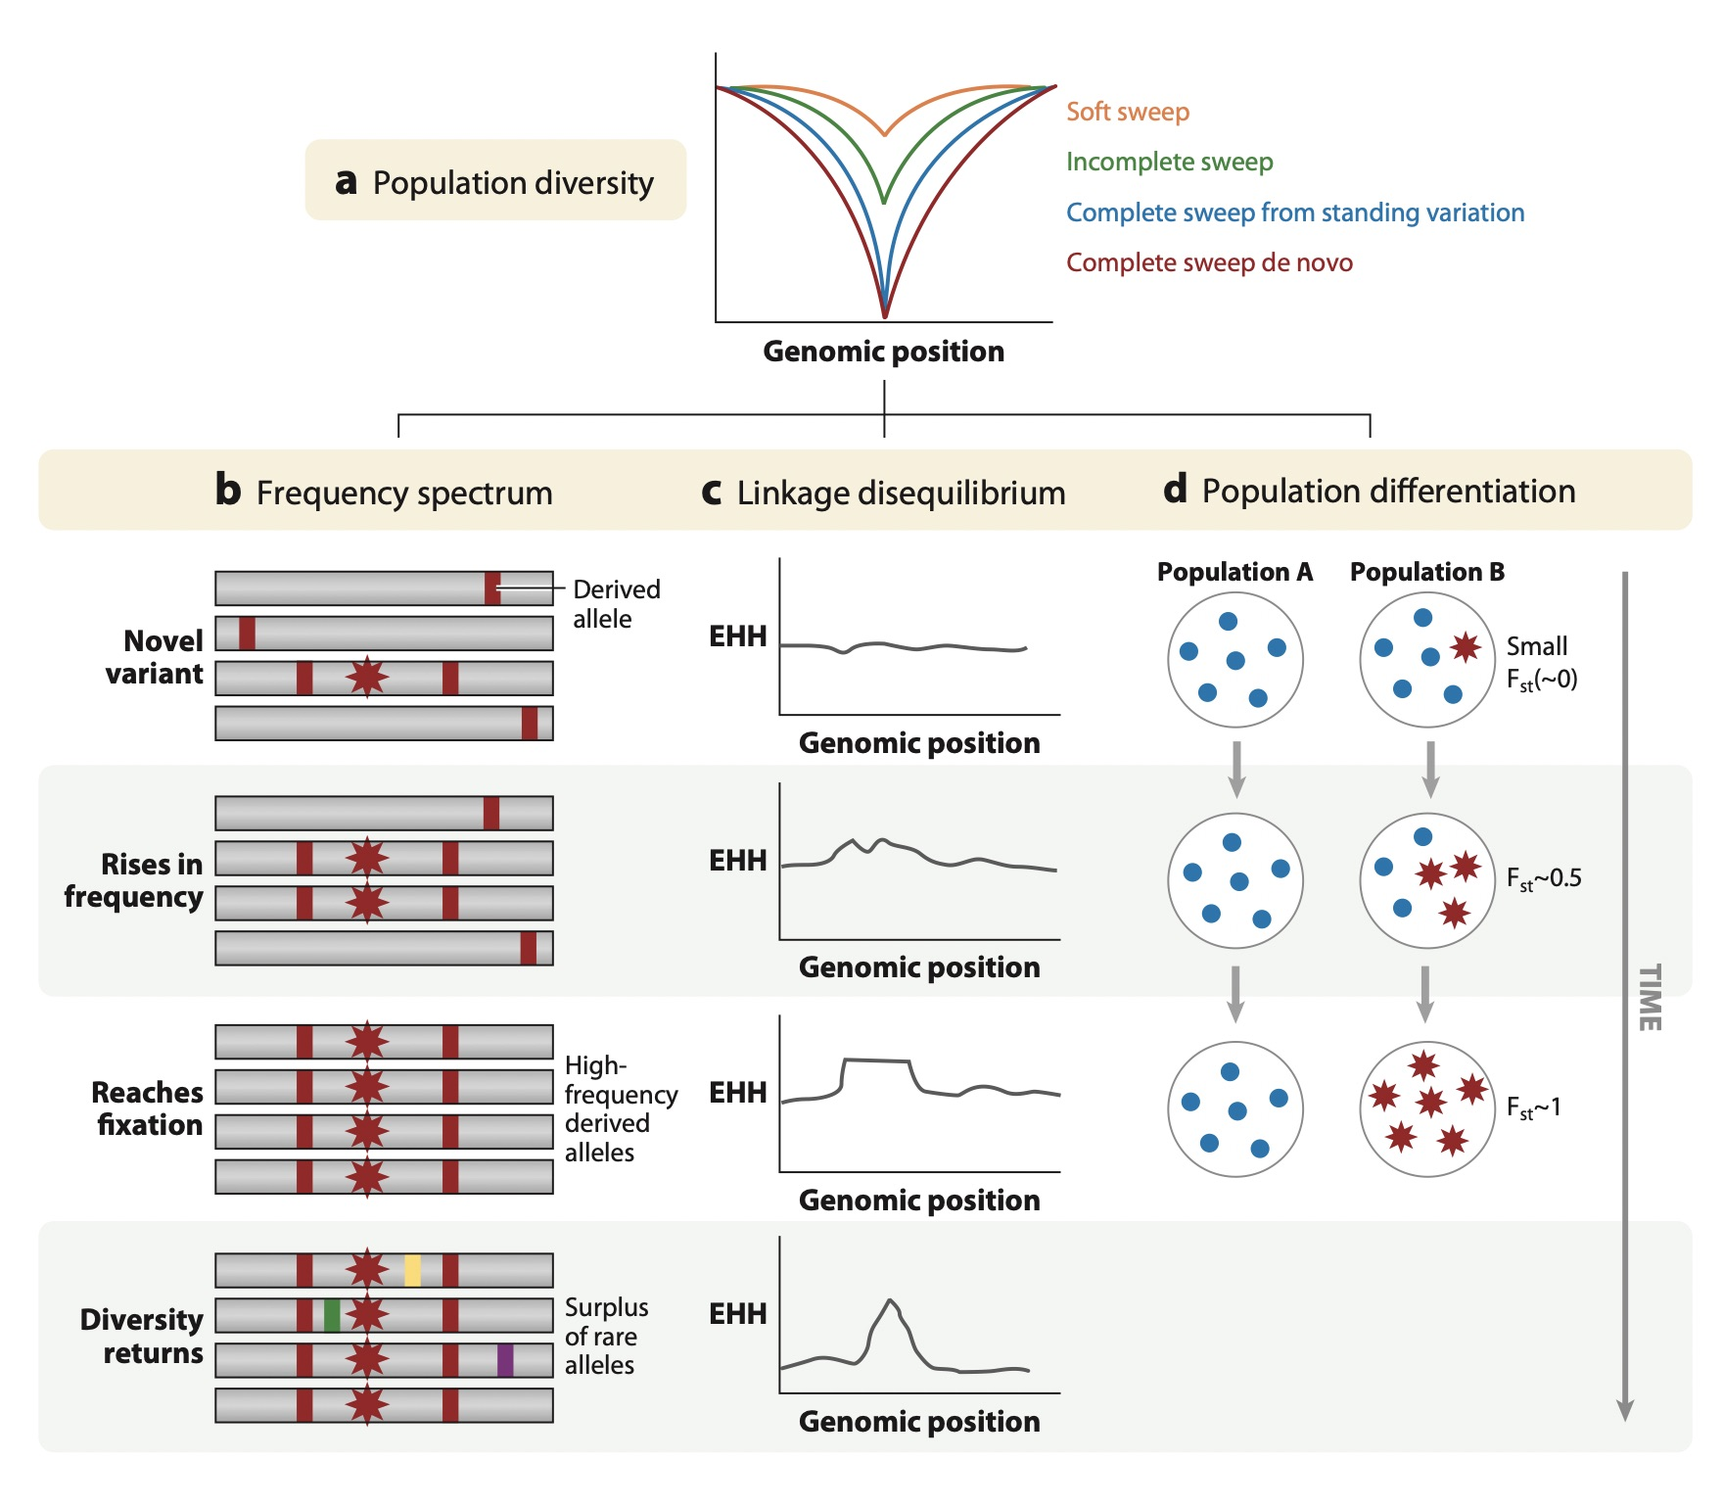
Effect on differentiation statistics
Increase in FST
Increase in Population Branch Tests
More sophisticated methods exist (e.g. BAYPASS). See Friday’s lecture on GEA.

Slide 30
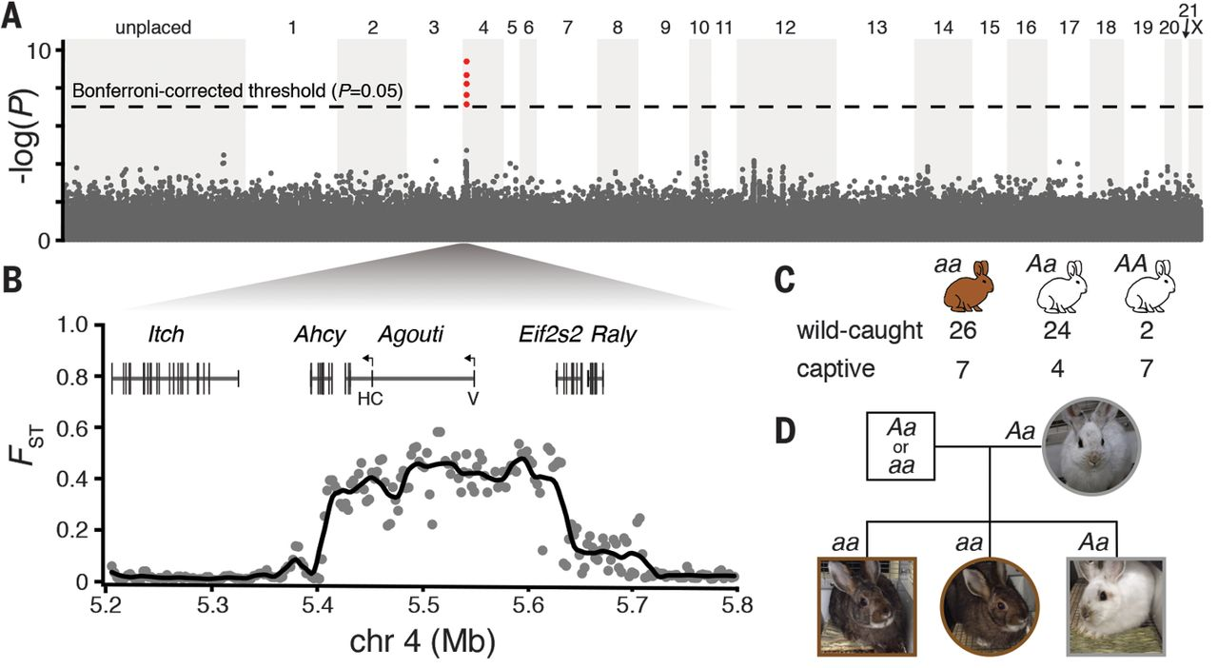
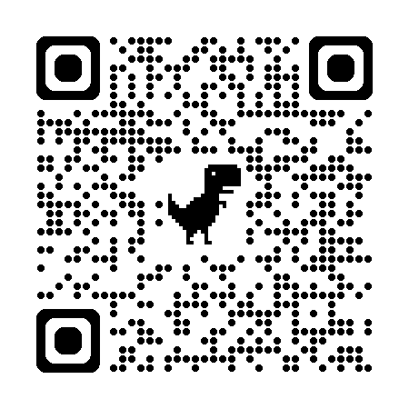
Scans of Differentiation
GWAS on exome data (large sample size)
Differentiation scan on low-depth genomes
Notes:
Loci under selection should display an association with the selective pressure, such as alleles providing an advantage in a given condition are more frequent. Loci that are not giving any advantage do not show any particular signal. You can perform a scan on many individuals and populations, identify these loci with allele frequencies which are the most associated to environmental conditions, then come back at you individuals and populations and predict how adapted they are to the local environment.
You can then identify populations/individuals that display high frequencies at these alleles and assume they are more adapted to a given condition

Slide 31
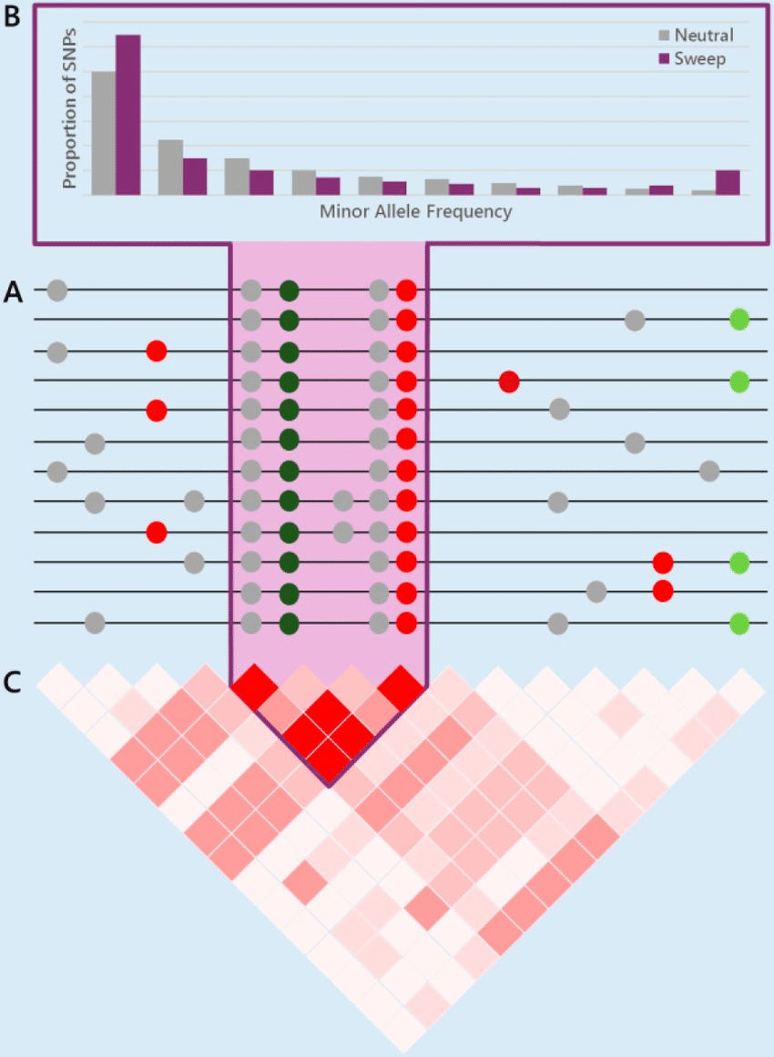
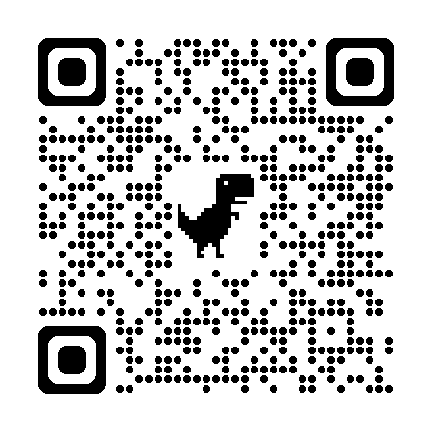
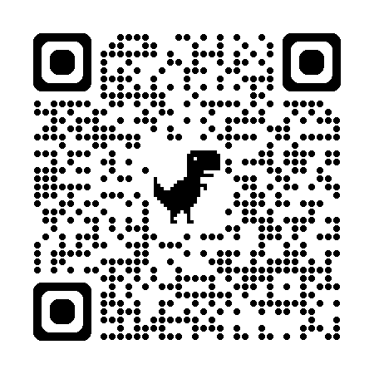
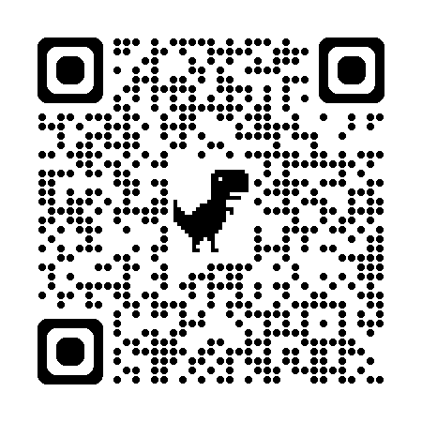
Effect on Linkage
The association between alleles across individuals breaks down because of recombination
Recent selection leads to a fast increase in frequency of the selected allele and those at the vicinity (selective sweep)
Selected haplotypes are frequent but have had less time to recombine with non-selected ones
Can be detected by methods based on haplotype extension (Sabeti et al. 2006, see methods such as rehh, in the workshop). OmegaPlus is also based on LD.
Requires phasing to be efficient.

Slide 32
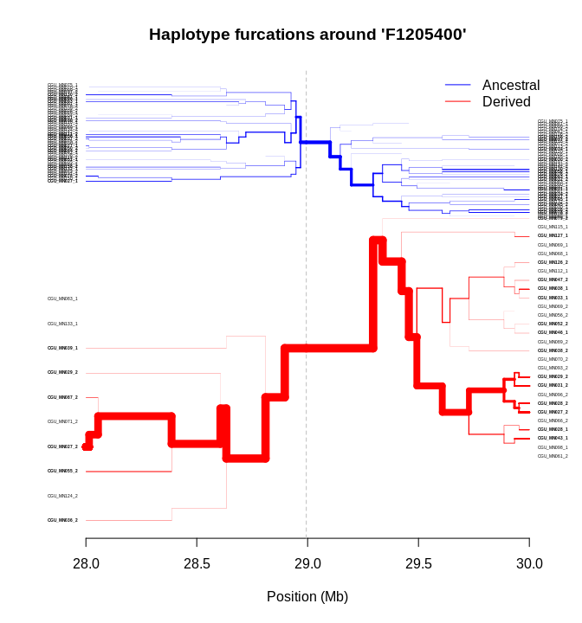
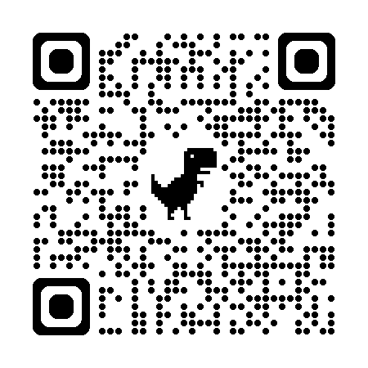
Effect on Linkage
The association between alleles across individuals breaks down because of recombination
Recent selection leads to a fast increase in frequency of the selected allele and those at the vicinity (selective sweep)
Can be detected by methods based on haplotype extension (e.g. iHS score, in rehh, see workshop)
Possible to compare extension across populations instead of within (XP-EHH, Rsb).

Slide 33
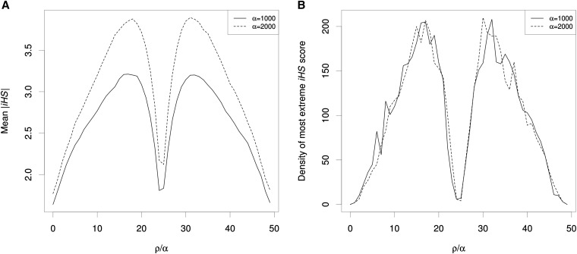
Effect on Linkage
The association between alleles across individuals breaks down because of recombination
Recent selection leads to a fast increase in frequency of the selected allele and those at the vicinity (selective sweep)
Can be detected by methods based on haplotype extension (e.g. rehh, see workshop)
If the sweep is fixed, there is only the derived allele at the centre, and the iHS score can not be computed

Slide 34
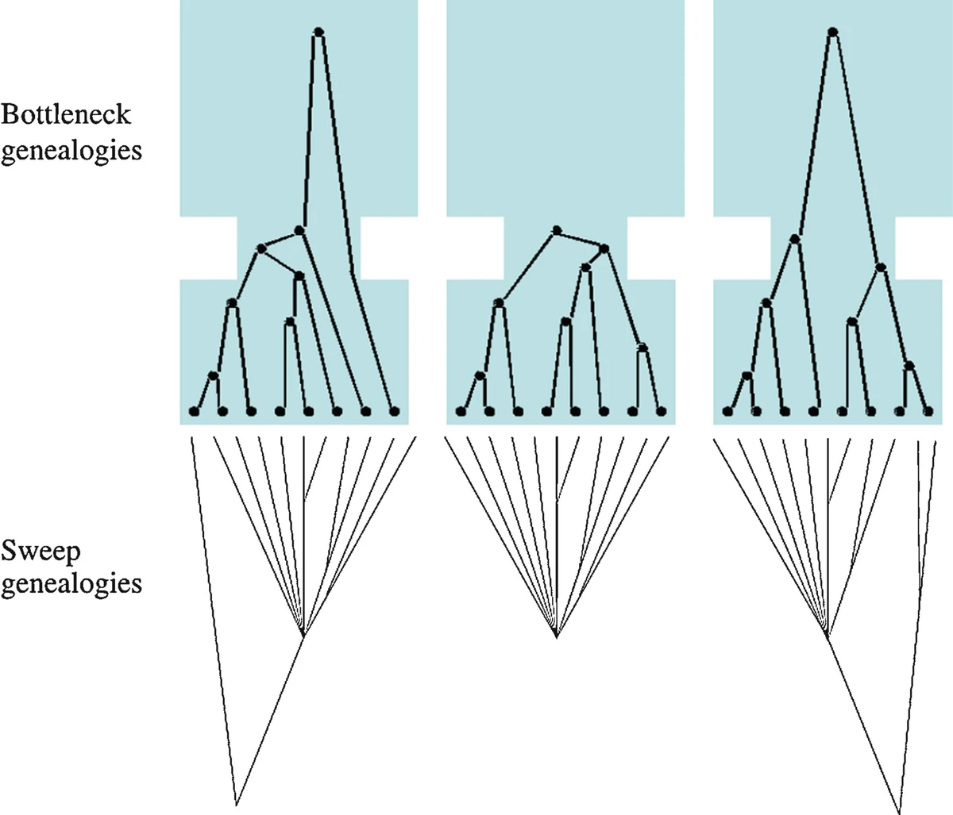
Effect on local genealogies, and a problem...
But selection acts locally and demography over the whole genome.
Right?? … …
Issue of variance...

Slide 35
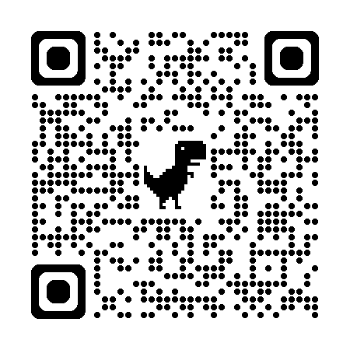
The ideal situation
This part can
be challenging beyond a few model species
Recent developments (e.g. Nanopore) make it easier
This part is not yet fully doable for many species
One can however use extensive databanks from model species (e.g. bank of mutants in Arabidopsis).
Risk of storytelling.
Risk of lack of functional conservation

Slide 36
More complicated. Soft and partial sweeps

Slide 37
Confounding factors

Slide 38
‘Linked’ selection
Hill-Robertson interference
Selective sweep
Müller’s ratchett
Background selection
(Maynard-Smith & Haig 1974)
(Muller 1932)
(Charlesworth et al. 1993)
(Hill & Robertson 1966)
Haplotypes drift
Selection favours the selected variant
Haplotypes drift. Random loss of the non-deleterious haplotype.
Counterselection of deleterious variant
Loss of advantageous variants
Loss of polymorphism and fixation of deleterious variants
Fixation of deleterious variant (‘click’ of the ratchett)
The linked advantageous variant is lost.
Strongly advantageous
Weakly advantageous
Mildly deleterious
Weakly deleterious
Neutral

Slide 39
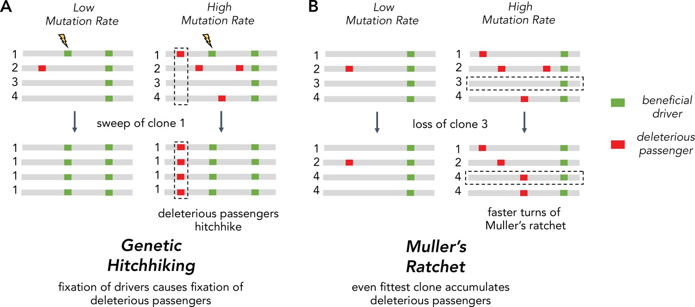
‘Linked’ selection
Note that we consider populations that sexually reproduce, but if recombination is locally low relative to mutation, we converge to this clonal case
https://doi.org/10.7554/eLife.67790

Slide 40
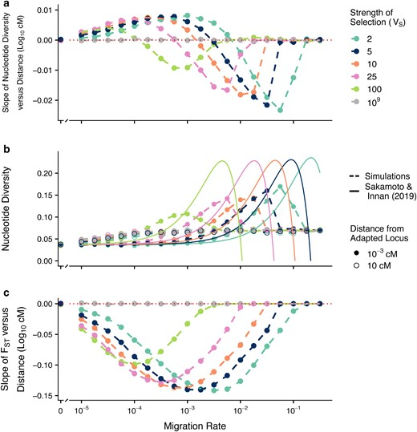
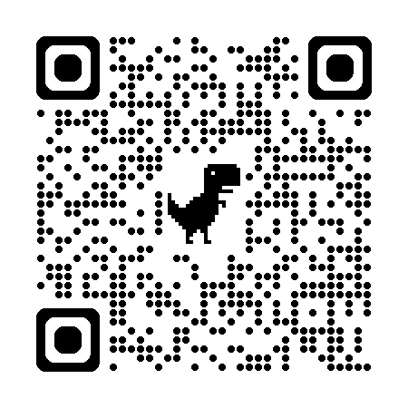
Confounding factors
Local adaptation might show more complicated patterns
This is due to the interplay between selection, recombination, and migration
Recent simulation studies suggest that both peaks and throughs in diversity are possible
Think of the scale at which the sweep may have happened.
Whenever possible, run simulations to get a sense of what you may expect/detect.

Slide 41
Reconstruct past genealogies and population structure
Coalescence rate and topology will change if there is selection at a gene
Genealogies at distant loci are less similar than ones at closely linked loci (because of recombination breaking associations between alleles within a chromosome)
Bourgeois et al. 2017 RSOS

Slide 42
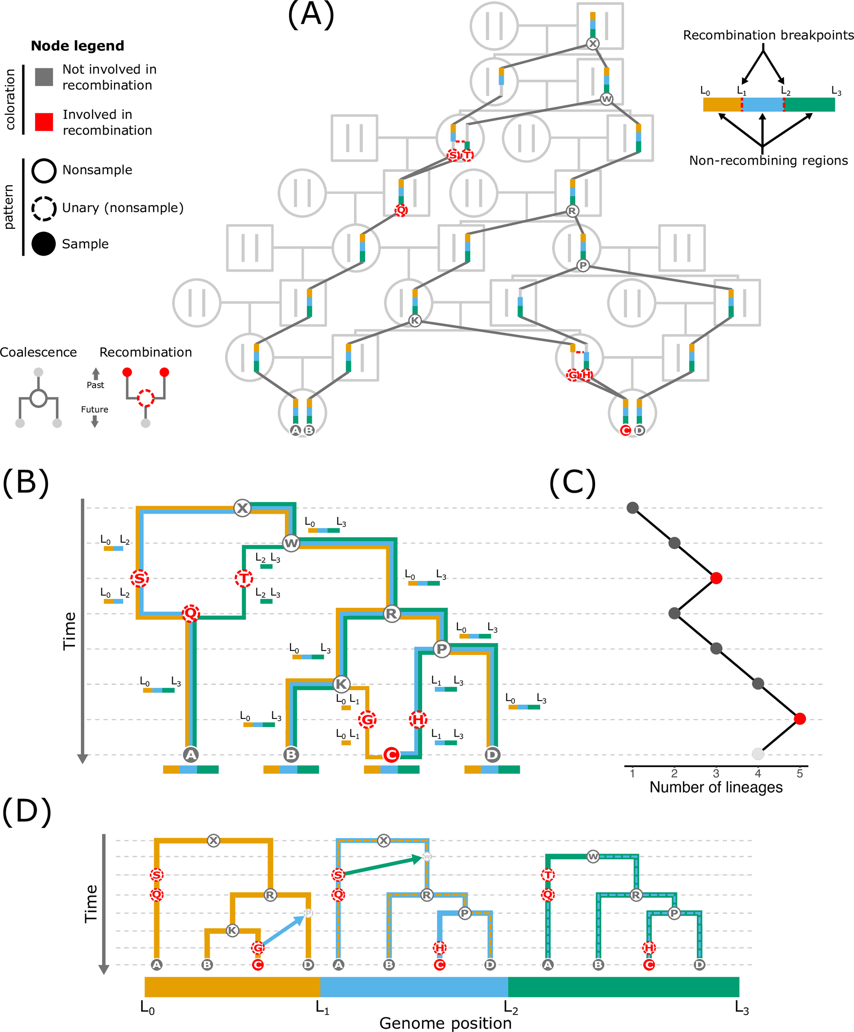
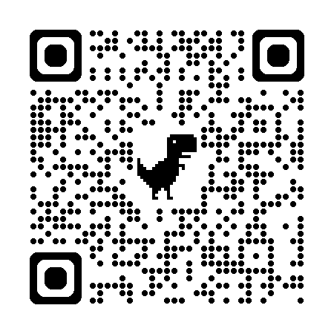
Reconstruct past genealogies and population structure
One can reconstruct genealogies using polymorphisms along the genome
The rate at which new branches merge from present to past is inversely correlated with population size (small populations -> high rates of coalescence)
Local deviations in genealogies and recombination can be fully described (ARGWeaver, Relate)
Can be used to reconstruct allele frequency over time and infer s (CLUES2)

Slide 43


Integration of signals: machine learning (summary statistics)
Machine and deep learning share a principle with ABC (and they overlap)
We simulate neutral and selected datasets, obtain summary statistics, and compare them to observations through a trained algorithm.
Possible advantage compared to ABC: fewer issues with the choice of summary statistics.
diploS/HIC and S/HIC

Slide 44


Integration of signals: machine learning (Ancestral Recombination Graphs)
Method implemented in SIA
Recurrent Neural Network
https://github.com/CshlSiepelLab/arg-selection

Slide 45


Integration of signals: machine learning (image recognition)
Direct image recognition is also seducing in principle to get rid of summary statistics
Take the alignment and train the algorithm to recognize images that fit with a sweep
Fast- NN (takes the vector of frequencies as an image).
SweepNet (takes the alignment as an image).

Slide 46

Balancing selection.
This is an umbrella term, covering processes that maintain genetic diversity over time at a locus. Especially interesting to people working on diversifying processes, such as host-parasite interaction, or self-incompatibility.
Think of a partial sweep that never gets fixated.
The main challenge here is the loss of linkage over evolutionary times, which may make the signal very narrow.

Slide 47
Long-term balancing selection.
The genealogies near a locus under long-term balancing selection should be older. ARGs can be useful here.
However, this is also dangerous: misalignment in your (short read) data along undetected paralog loci may lead to false signals
Very old balancing selection can also involve very divergent haplotypes, making alignment impossible.

Slide 48


Long-term balancing selection.
The genealogies near a locus under long-term balancing selection should be older. ARGs can be useful here.
However, this is also dangerous: misalignment in your (short read) data along undetected paralog loci may lead to false signals
Very old balancing selection can also involve very divergent haplotypes, making alignment impossible.

Slide 49


Long-term balancing selection.
The genealogies near a locus under long-term balancing selection should be older. ARGs can be useful here.
However, this is also dangerous: misalignment in your (short read) data along undetected paralog loci may lead to false signals
Very old balancing selection or gene conversion can also lead to very divergent haplotypes, making alignment impossible.

Slide 50


Detecting Balancing selection: LD.
The β statistic method can work without specifying ancestral and derived alleles (useful in non-model species)
It is fast.
Same issues of mappability of short reads to take into account.

Slide 51




Detecting Balancing selection: Spectrum.
BalLeRMix+. Method can work without specifying ancestral and derived alleles (useful in non-model species)
It is fast. Robust to the choice of window’s size.
Benefits from an outgroup to include divergence with polymorphism.

Slide 52

Detecting Balancing selection: Spectrum.
Those are two relatively user-friendly examples
For a full list of recent methods (2023), see:
Bárbara D Bitarello, Débora Y C Brandt, Diogo Meyer, Aida M Andrés, Inferring Balancing Selection From Genome-Scale Data, Genome Biology and Evolution, Volume 15, Issue 3, March 2023, evad032, https://doi.org/10.1093/gbe/evad032

Slide 53


Highly polygenic selection.
Implemented in PALM
Obtain effect sizes for SNPs
associated with a trait of interest
Reconstruct allele trajectories through time and infer selective coefficients
Obtain genome-wide genealogies

Slide 54


A final note: the concept of mutation load
Not everything in selection is positive...
The genomic burden of deleterious variants is being more and more studied in conservation.
Demographic processes are important.
May be extremely important in adaptability.

Slide 55

A final note: the concept of mutation load
Not everything in selection is positive...
The genomic burden of deleterious variants is being more and more studied in conservation.
Demographic processes are important.
May be extremely important in adaptability.

Slide 56
A few questions now...
Which methods or statistics are the most suited to detect ancient balancing selection in a genome scan?
A - Extended Haplotype Homozygosity (EHH)
B - Population Branch Statistic (PBS)
C - β statistic based on LD
D - BalLeRMix based on the allele frequency spectrum
E - Local ancestry painting (e.g., PCAdmix)

Slide 57
A few questions now...
Which methods or statistics are the most suited to detect ancient balancing selection in a genome scan?
A - Extended Haplotype Homozygosity (EHH)
B - Population Branch Statistic (PBS)
C - β statistic based on LD
D - BalLeRMix based on the allele frequency spectrum
E - Local ancestry painting (e.g., PCAdmix)

Slide 58
A few questions now...
What pattern is typically expected near a locus under a recent hard selective sweep?
A - Low genetic diversity near the selected locus
B - Increase in heterozygosity near the selected locus
C - Extended haplotype homozygosity around the selected allele
D - An increase in Tajima’s D values
E - Decrease in linkage disequilibrium near the selected locus

Slide 59
A few questions now...
What pattern is typically expected near a locus under a recent hard selective sweep?
A - Low genetic diversity near the selected locus
B - Increase in heterozygosity near the selected locus
C - Extended haplotype homozygosity around the selected allele
D - An increase in Tajima’s D values
E - Decrease in linkage disequilibrium near the selected locus

Slide 60
A few questions now...
Which of the following statements about GWAS is correct?
A - Chi-squared tests are ideal for continuous traits
B - Logistic regression is used for binary phenotypes
C - GWAS can be affected by population structure
D - Bonferroni correction decreases the false negative rate
E - GWAS assumes strong selection at each tested locus

Slide 61
A few questions now...
Which of the following statements about GWAS is correct?
A - Chi-squared tests are ideal for continuous traits
B - Logistic regression is used for binary phenotypes
C - GWAS can be affected by population structure
D - Bonferroni correction decreases the false negative rate
E - GWAS assumes strong selection at each tested locus

